Slide 1
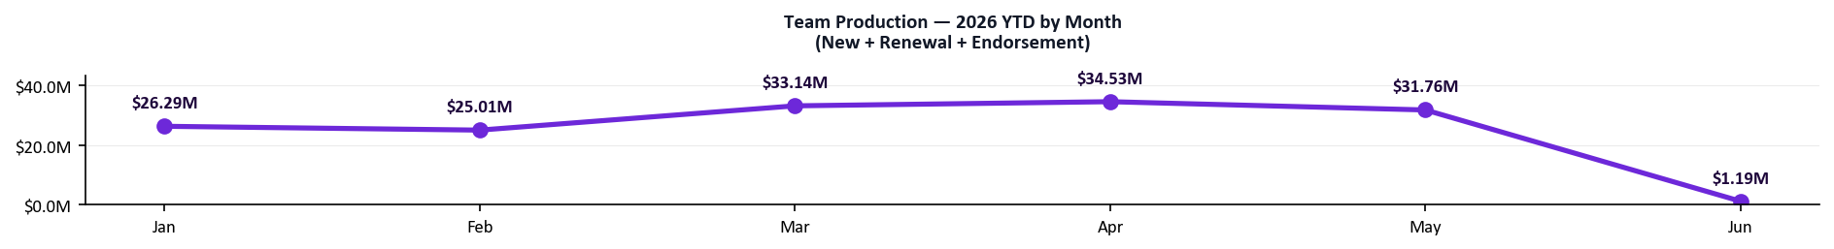
Q2 Team Scoreboard
Generated Jun 01, 2026
As of Jun 01, 2026 | 62 days into Q2 | 29 days remaining
$22.4M
82%
35,384
9
Team GWP Q2 YTD | Proj. $32.9M
Activity Compliance Q2
Submissions Q2 YTD
Net New Agencies Appointed
Pacing 173% of Q1 Final
AT RISK
Pacing 107% of Q1 Final
38% of Goal | 9 / 24 target
▲ $2.5M vs May pace
▲ 40pp vs Q1 avg (43%)
▲ 18511 vs May (16873)
▲ 5 vs Q1 final (4)
Q2 MIX
$31.8M
$9.4M
$3.2M
New Business (72%)
Renewals (21%)
Endorsements (7%)
$19.0M
43%
48,449
4
Q1 FINAL
GWP
Activity
Submissions
Agencies Appointed
MTD (Jun): $0.49M written · $14.63M pace · 1/30 days elapsed
Notes:
PURPOSE
Gives every rep a single-page snapshot of where the team stands in Q2 before diving into individual performance.
HOW THE NUMBERS ARE CALCULATED
- Team Q2 GWP: sum of all bound premium written by BDMs + BDAs since Apr 1.
- Q2 Projected Finish: (Q2 GWP to date ÷ days elapsed) × 91 days in the quarter, shown as "Proj." in the GWP tile label.
- Q2 Submissions: total submission count from agencies assigned to Growth Team reps since Apr 1.
- Activity Compliance Q2: each rep's weekly calls + meetings averaged across Q2 weeks vs. weekly goal (40 BDMs / 50 BDAs). This tile shows the team average.
- Net New Agencies Appointed: count of "Activated Won" deals in the HubSpot NNA pipeline since Apr 1, BDMs only, filtered to deal names starting with "Appointed - " (true new appointments — excludes "Already appointed", "No deal received", "Duplicate", and pending paperwork tags). Goal = 4 per BDM per quarter. Green = at goal, amber = halfway, red = behind.
- Badge pills: GWP and Submissions badges show pacing vs. Q1 Final total. Activity badge shows On Track / At Risk / Behind.
- "vs last month" comparison: each box shows a delta vs the prior month (or Q1 avg for activity/agencies). Green ▲ = improving, red ▼ = declining.
- Q2 MIX strip (purple): breaks the Q2 GWP figure into New Business / Renewals / Endorsements with each segment's $ amount and % of total. Shows what the team controls (gross production before cancellations).
- Q1 Final strip (gray): Q1 full-quarter actuals for each metric — GWP, Activity %, Submissions, Agencies Appointed. Use as the benchmark for the four KPI tiles above.
- MTD Pace: (GWP written this month to date ÷ days elapsed this month) × total days in the month.
- YTD chart: total company Production per month (New + Renewal + Endorsement) for each month of 2026. GWP elsewhere on the deck is net of Cancellations and Reinstatements per Nyles's definition; Production is the gross "what was written" view used here.
WHAT TO LOOK FOR
- Read top to bottom: tiles answer "where are we vs goal?", Q2 MIX answers "what's driving GWP?", Q1 Final answers "how does this compare to last quarter?", MTD bar answers "are we on pace this month?", trend chart shows the trajectory.
- If Q2 MIX shows endorsements running unusually high relative to NB, the headline GWP is leaning on existing-book activity, not new wins.

Slide 2
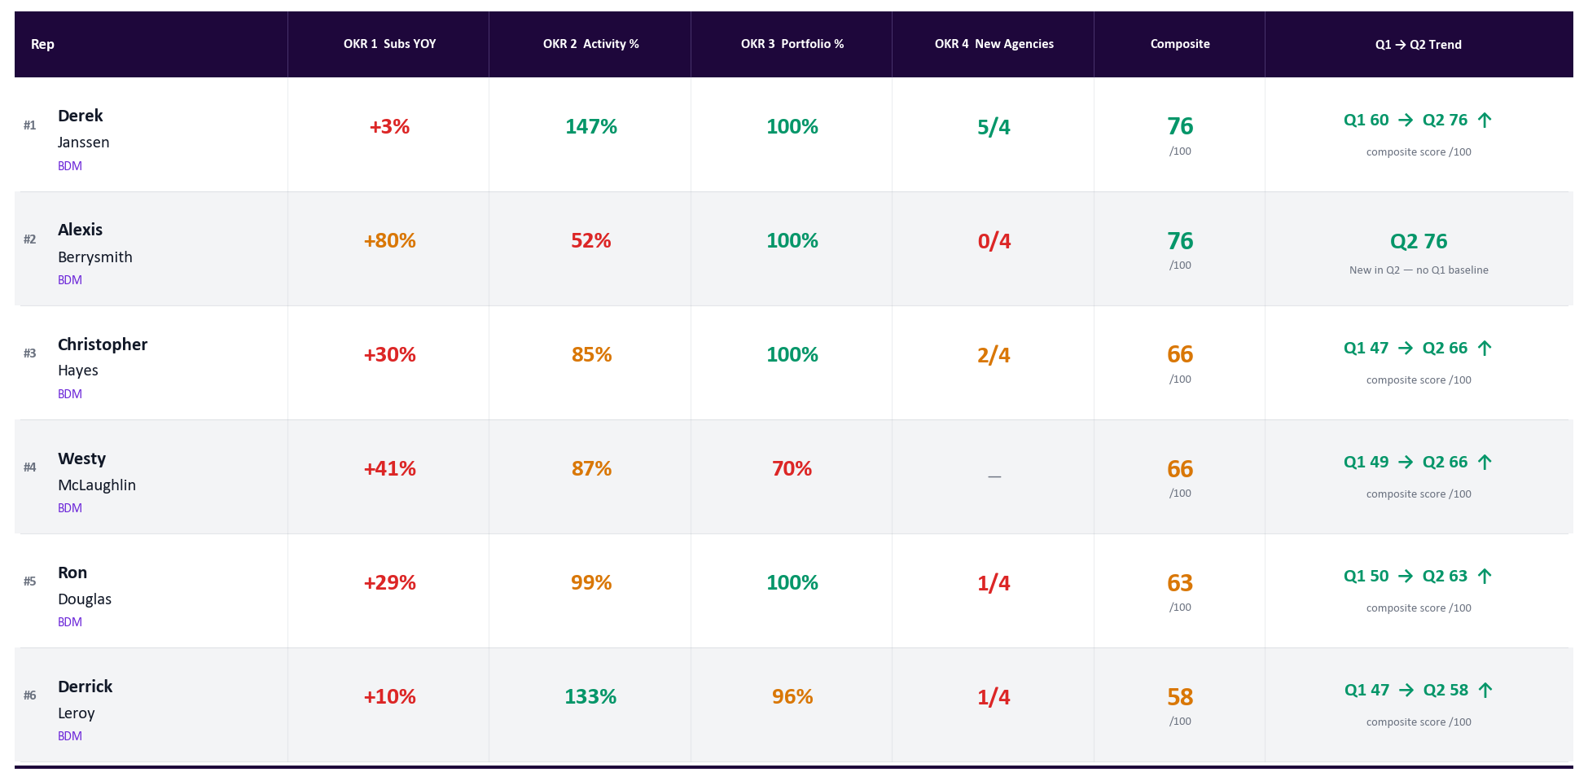
BDM Performance Rankings — Q2 2026
Generated Jun 01, 2026
Q2 2026 YTD (Apr 1–Jun 01) | Green = on target | Amber = at risk | Red = behind | Goal: ≥40 acts/wk | Ranked by composite OKR score
Notes:
PURPOSE
Shows where every BDM ranks in Q2. The goal is transparency — everyone sees the same numbers so there are no surprises.
HOW THE NUMBERS ARE CALCULATED
- Q2 GWP: total bound premium written by the rep since Apr 1.
- Q2 Subs: total submission count (quotes + applications) for the rep since Apr 1.
- OKR 1 — Subs YOY %: (Q2 subs to date this year ÷ same date range last year) − 1. Green = +100% or more vs. last year.
- OKR 2 — Activity %: (avg weekly calls + meetings) ÷ 40 goal. Green = 100%+. Amber = 75–99%. Red = below 75%.
- OKR 3 — Portfolio Active %: active agencies ÷ total assigned agencies. Active = any 2026 submission on the agency from any source (BDM, BDA, or direct). Green = 75%+.
- OKR 4 — New Agencies: count of "Activated Won" deals in the HubSpot NNA pipeline since Apr 1, filtered to deal names starting with "Appointed - " (excludes "Already appointed", "No deal received", "Duplicate", and pending paperwork). Goal = 4 per quarter.
- Composite Score /100: weighted blend of all 4 OKRs. Higher = stronger overall Q2 performance.
- Trend arrow and Q1→Q2 score: composite score from Q1 final vs. Q2 current — shows whether a rep is improving or declining.

Slide 3
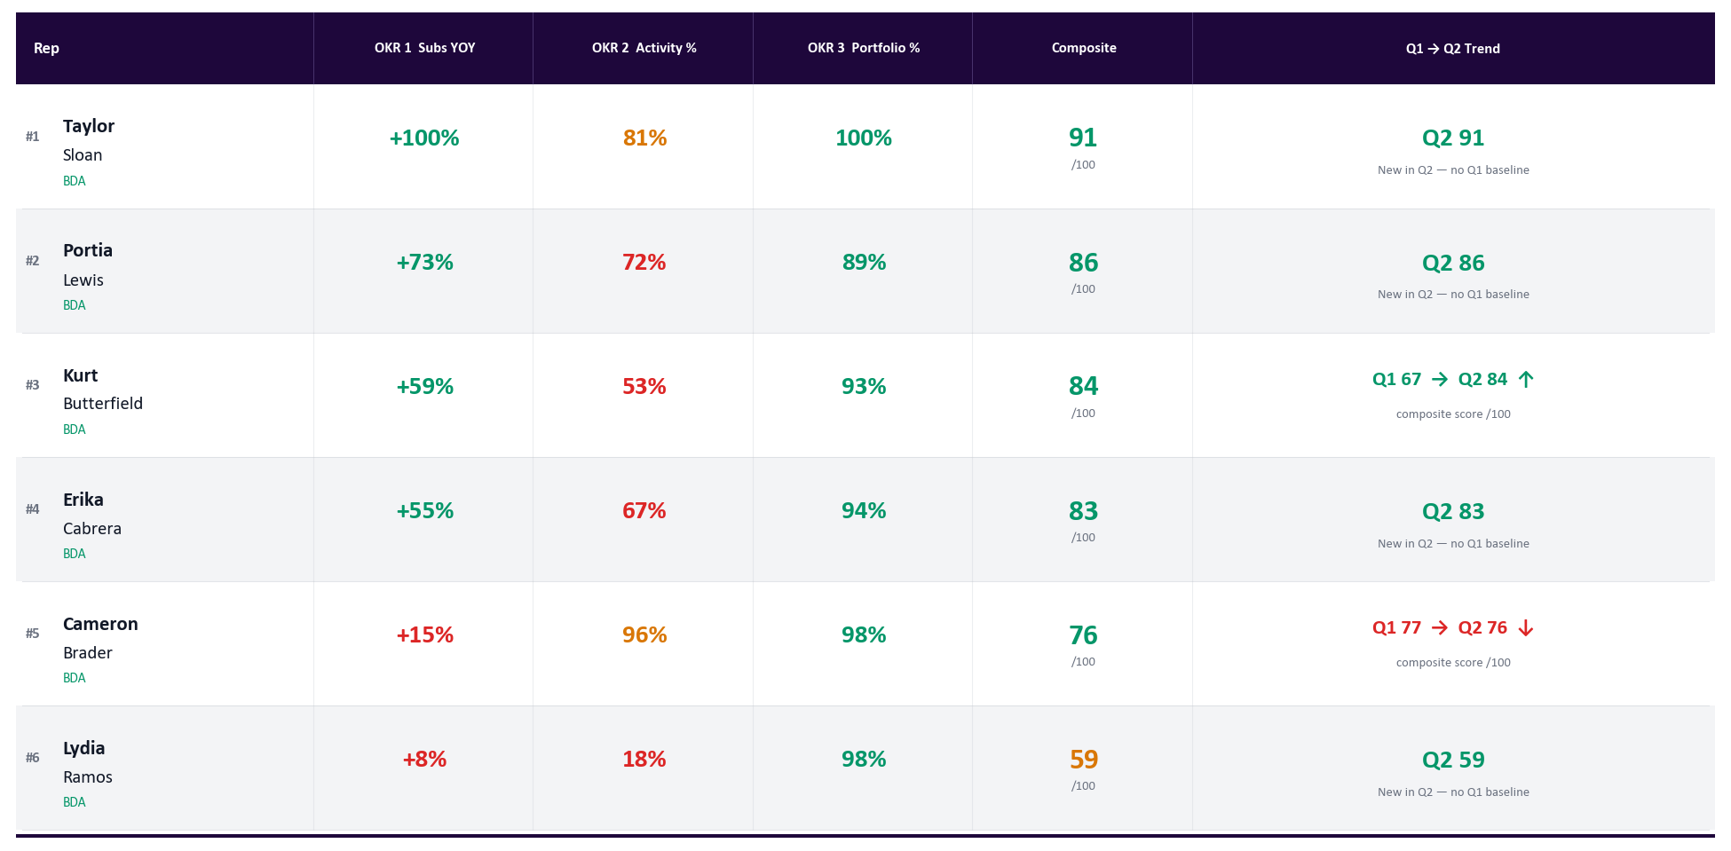
BDA Performance Rankings — Q2 2026
Generated Jun 01, 2026
Q2 2026 YTD (Apr 1–Jun 01) | Green = on target | Amber = at risk | Red = behind | Goal: ≥50 acts/wk | Ranked by composite OKR score
Notes:
PURPOSE
Same ranking view as BDMs but for BDAs. BDAs have a higher activity goal and do not have an OKR 4 (new agency activation).
HOW THE NUMBERS ARE CALCULATED
- Q2 GWP and Subs: same as BDMs — bound premium and submission count since Apr 1.
- OKR 1 — Subs YOY %: (Q2 subs to date ÷ same period last year) − 1. BDA Q2 accountability started Apr 20 for Cabrera, Lewis, and Sloan — their YOY is calculated from that date forward.
- OKR 2 — Activity %: (avg weekly calls + meetings) ÷ 50 goal. BDA goal is 50 acts/week, not 40.
- OKR 3 — Portfolio Active %: same formula as BDMs. Active = any 2026 submission on the agency from any source. Green = 75%+ of assigned agencies active. BDA target = 70%.
- Composite Score /100: weighted blend of OKRs 1–3 (no OKR 4 for BDAs).
- Trend: Q1 composite score vs. Q2 current composite — arrow shows direction of change.

Slide 4
Activity Dashboard — Q2 2026 | BDMs | Calls + Meetings
Generated Jun 01, 2026
Q2 YTD | Apr 1–Jun 01 | BDMs Only | Goal: 40 acts/wk | Emails excluded
Rep
Apr 13-19
Apr 20-26
Apr 27-May 3
May 4-10
May 11-17
May 18-24
May 25-31
Jun 1-1
Avg %
Derek Janssen
58
67
63
43
53
48
50
0
147%
Ron Douglas
43
34
47
0
57
72
47
2
99%
Christopher Hayes
42
25
40
15
45
35
30
0
85%
Derrick Leroy
48
64
51
54
60
42
58
1
133%
Westy McLaughlin
29
28
39
25
45
35
32
1
87%
Alexis Berrysmith
0
4
0
32
45
43
41
0
52%
Rep
Role
Calls
Meetings
Inbound
Total
Avg/Wk
% to Goal
Derek Janssen
BDM
479
47
101
526
58.9
147%
Ron Douglas
BDM
295
27
88
322
39.6
99%
Christopher Hayes
BDM
271
13
38
284
33.9
85%
Derrick Leroy
BDM
457
20
56
477
53.4
133%
Westy McLaughlin
BDM
275
17
52
292
34.9
87%
Alexis Berrysmith
BDM
148
17
17
165
20.6
52%
Notes:
PURPOSE
Shows week-by-week activity for every BDM. Activity is the leading indicator — GWP follows from consistent outreach.
HOW THE NUMBERS ARE CALCULATED
- Each cell = total calls + meetings logged in HubSpot for that rep in that calendar week. Emails are excluded.
- Goal = 40 acts/week per BDM.
- Green = 40+ (100% of goal). Amber = 30–39 (75–99%). Red = below 30 (<75%). Gray = zero logged that week.
- Avg % (right column): average of each week's (acts ÷ 40) across all Q2 weeks to date. This is the same number shown in OKR 2 on the rankings slide.
- Summary table below the heatmap: Calls and Meetings are Q2 totals. Avg/Wk = total acts ÷ weeks elapsed. % to Goal = Avg/Wk ÷ 40.
- BDA Activity Dashboard is on the next slide.

Slide 5
Activity Dashboard — Q2 2026 | BDAs | Calls + Meetings
Generated Jun 01, 2026
Q2 YTD | Apr 1–Jun 01 | BDAs Only | Goal: 50 acts/wk | Emails excluded
Rep
Apr 13-19
Apr 20-26
Apr 27-May 3
May 4-10
May 11-17
May 18-24
May 25-31
Jun 1-1
Avg %
Cameron Brader
58
38
57
53
48
43
57
0
96%
Erika Cabrera
21
39
14
57
54
48
0
67%
Portia Lewis
33
34
53
42
43
45
2
72%
Taylor Sloan
48
58
54
43
31
50
0
81%
Kurt Butterfield
0
1
0
39
61
60
51
0
53%
Lydia Ramos
0
0
0
1
1
6
62
0
18%
Rep
Role
Calls
Meetings
Inbound
Total
Avg/Wk
% to Goal
Cameron Brader
BDA
407
10
43
417
48.1
96%
Erika Cabrera
BDA
221
12
16
233
33.3
67%
Portia Lewis
BDA
236
16
40
252
36.0
72%
Taylor Sloan
BDA
270
14
21
284
40.6
81%
Kurt Butterfield
BDA
205
7
11
212
26.5
53%
Lydia Ramos
BDA
65
5
8
70
8.8
18%
Notes:
PURPOSE
Same heatmap layout as BDMs but for BDAs. BDAs have a higher weekly goal because outbound activity is the core of their role.
HOW THE NUMBERS ARE CALCULATED
- Each cell = calls + meetings for that BDA in that week. Emails excluded.
- Goal = 50 acts/week per BDA.
- Green = 50+ (100%). Amber = 37–49 (75–99%). Red = below 37 (<75%). Gray = zero logged.
- Erika Cabrera, Portia Lewis, and Taylor Sloan: gray cells before the week of Apr 20 are expected — their Q2 activity accountability started that week, so earlier weeks are grayed out rather than shown as red.
- Avg % (right column): average of each week's (acts ÷ 50) across the weeks they are accountable for. Matches OKR 2 on the rankings slide.
- Summary table: totals are counted from Apr 1 for all BDAs, except Cabrera/Lewis/Sloan whose calls and meetings are counted from Apr 20.
- BDM Activity Dashboard is on the previous slide.

Slide 6
Account Health & Agency Engagement — Retail Only
Generated Jun 01, 2026
BDMs + BDAs | Per-rep counts = each rep's full HubSpot book (assignment = Retail filter) | Unassigned row = HubSpot vertical=Retailer only
Rep
Portfolio
Active
Dormant
Eng. %
Q1 GWP
Q2 Subs
Q2 Binds
Q2 GWP
Q2 Renew
Q2 Cancel
Derek Janssen
53
53
0
100%
$19.0M
7526
535
$19.0M
$4.7M
$4.3M
Christopher Hayes
45
45
0
100%
$11.7M
3630
371
$10.1M
$1.5M
$3.1M
Ron Douglas
34
34
0
100%
$9.7M
5832
335
$9.7M
$1.5M
$4.0M
Derrick Leroy
28
27
1
96%
$7.6M
3583
275
$6.7M
$921K
$2.0M
Alexis Berrysmith
22
22
0
100%
$5.8M
1969
126
$3.9M
$126K
$1.8M
BDAs — Business Development Associates (goal: ≥70% portfolio active)
Kurt Butterfield
45
42
3
93%
$2.9M
4358
113
$2.6M
$213K
$870K
Lydia Ramos
54
53
1
98%
$2.2M
1884
71
$2.1M
$86K
$570K
Portia Lewis
53
47
6
89%
$1.1M
1718
41
$1.5M
$38K
$382K
Erika Cabrera
45
42
3
93%
$890K
3016
52
$1.3M
$3K
$273K
Cameron Brader
50
49
1
98%
$994K
991
54
$1.0M
$316K
$153K
Taylor Sloan
27
27
0
100%
$728K
647
27
$917K
$61K
$316K
Unassigned Retail Agencies — Retail-vertical agencies that submitted but are not yet assigned to a rep
Unassigned
169
169
—
—
$9.5M
6259
248
$7.1M
$1.6M
$2.6M
BDMs
BDAs
TEAM
182 portfolio · 181 active · 1 dormant
274 portfolio · 260 active · 14 dormant
456 portfolio · 441 active · 97% engaged
Notes:
SCOPE — RETAIL VERTICAL ONLY
This slide is filtered to HubSpot companies tagged vertical = "Retailer". Networks, National Partners, and agencies with blank/missing vertical are excluded from BOTH per-rep counts AND the Unassigned row. Other team verticals are tracked on their own scoreboards.
PURPOSE
Shows how actively each rep is working their assigned RETAIL book. An agency assigned but not submitting in 2026 is a missed opportunity. Engagement % (OKR 3) is the headline number per rep.
HOW THE NUMBERS ARE CALCULATED
- Portfolio: Retail-vertical agencies assigned to the rep in HubSpot. BDMs matched via owner_2; BDAs via onboarding_success_agent. Non-Retail agencies in a rep's HS book are excluded from this count.
- Active: agencies in the rep's Retail book with at least one 2026 submission from any source (including subs that came through a BDA below the BDM). Uses a normalized name match.
- Dormant: Portfolio − Active. Specific names are listed on the next slide.
- Eng. % (OKR 3): Active ÷ Portfolio × 100. Green = 75%+. Amber = 50–74%. Red = below 50%. BDM target = 100%. BDA target = 70%.
- Q1 GWP: Q1 2026 gross written premium from this rep's Retail book.
- Q2 Subs / Binds / GWP: Q2 2026 submission, bind, and bound-premium counts on the rep's Retail book.
- Q2 Renew / Cancel: GWP from Q2 renewals / cancellations on the rep's Retail book. If cancels approach renewals, that rep has a retention problem.
- Unassigned Retail row: Retail-vertical agencies that submitted in Q2 but do not map to any Growth Team rep's HubSpot book by name. Q1/Q2 GWP are summed directly from production data (dw_reader.policy_transaction_premium) — same source as per-rep GWP, filtered to producers not credited to any rep and matching the Retail-vertical set.

Slide 7
Dormant Agencies | Detail by Rep — Retail Only
Generated Jun 01, 2026
Retail-vertical agencies in each rep's HubSpot portfolio with zero 2026 submissions | Refreshed 2026-06-01
BDMs (1 reps with dormant agencies)
BDAs (5 reps with dormant agencies)
Derrick Leroy
1 dormant
Cameron Brader
1 dormant
1 of 28 agencies dormant
1 of 50 agencies dormant
•
Eagles Insurnace Agency Llc
•
Trinity Ins Services Llc
Erika Cabrera
3 dormant
3 of 45 agencies dormant
•
J.c.a. Consultant, Inc.
•
Simplex Group
•
True Coverage Insurance Agency, Llc
Portia Lewis
6 dormant
6 of 53 agencies dormant
•
Allstars Insurance Partners, Inc
•
Assured Insurance Consultants, LLC
•
Clark Farley Insurance Agency - A Relation Company
•
Lake Marion Agency LLC
•
Paramount Trucking Specialist Llc
•
Patrick Phillips Insurance Agency,
Kurt Butterfield
3 dormant
3 of 45 agencies dormant
•
Eagles Insurnace Agency Llc
•
Laredo Commercial Insurance Agency, Inc.
•
Meadors Adams And Lee
Lydia Ramos
1 dormant
1 of 54 agencies dormant
•
Wgb Raby Lp Dba Champion Risk & Insurance Services
+ 5 reps with 100% active portfolios are not shown (zero dormant agencies).
Notes:
PURPOSE
Pairs with the Account Health slide. That slide gave you the dormant count; this slide names the specific agencies so reps can act — call them, get a sub in, or escalate. Driving these counts down is the path to OKR 3 (100% portfolio engagement for BDMs, 70% for BDAs).
HOW THE LIST IS BUILT
- Portfolio per rep is pulled from HubSpot live: BDMs via owner_2, BDAs via onboarding_success_agent.
- An agency is DORMANT if it has zero 2026 submissions from any source (loose lens — same definition used on the Account Health slide). Name matching is normalized (strips LLC/Inc/Corp/DBA, punctuation, case) so 'Acme, LLC' and 'Acme LLC' match the same agency.
- Card color stripe codes severity: red (5+ dormant), orange (3–4), amber (1–2), green (0).
- Reps with zero dormant agencies aren't shown as empty cards — they're tallied in the footer line.

Slide 8
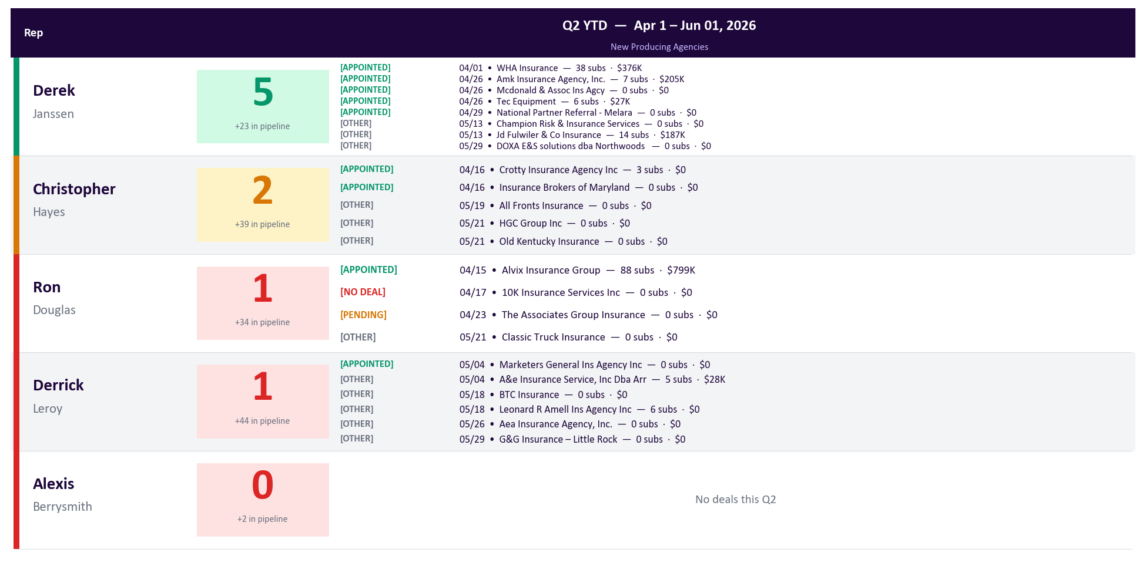
New Producing Agencies | Q2 YTD
Generated Jun 01, 2026
BDMs Only | All Activated-Won NNA deals shown w/ status tag + close date · OKR4 count = APPOINTED only · Goal: 4 per BDM/quarter
Notes:
PURPOSE
OKR 4 — tracks BDM appointment performance and whether each newly-appointed agency is actually producing. Two signals: did we sign them this quarter, and have they started submitting?
HOW THE NUMBERS ARE CALCULATED
- Source: HubSpot deals in the Net New Agency (NNA) pipeline, stage = 'Activated Won', closedate >= 2026-04-01.
- Filter: only deals whose name starts with 'Appointed - ' count toward the OKR. BDMs use deal name prefixes to tag outcomes — we only credit true new appointments.
• 'Appointed - <Agency>' → counts ✓
• 'Already appointed - <Agency>' → excluded (relationship pre-existed)
• 'No deal received - <Agency>' → excluded (paperwork never came back)
• 'Duplicate - <Agency>' → excluded
• 'Deal created / pending paperwork - <Agency>' → excluded (not closed yet)
- Goal = 4 true new appointments per BDM per quarter (20 team total). Green = 4+. Amber = 2–3. Red = 0–1.
- Each agency name on the slide has its 'Appointed -' prefix stripped and is suffixed with: (a) its Q2 submission count and (b) the bound GWP it has generated in Q2 (e.g., 'Acme Insurance — 3 Q2 subs · $145K GWP'). Zero Q2 subs = appointed but not producing yet (reactivation outreach). $0 GWP with subs > 0 = quoting but not binding (pricing or quality issue).
- '+X in pipeline' under the count = NNA deals still in earlier stages (Identified, Outreach, Discovery, Decision Maker Bought-In, Education, Intent to Partner, Onboarding/Setup). Near-term appointment pipeline.
- Q1 reference is in the appendix.
- We are 62 days into a 91-day quarter.

Slide 9
Team Wins — Top 20 Agencies Q2 2026
Generated Jun 01, 2026
Ranked by Q2 GWP (left) and Q2 Submissions (right) · Mint-shaded row = new vs last week’s deck · Apr 1–Jun 01
Top 20 Agencies — Q2 GWP Written
Top 20 Agencies — Q2 Submissions
#
Rep
Agency
Q2 GWP
#
Rep
Agency
Q2 Subs
1
Ron D.
USA SPECIALTY INSURANCE/DBA PREVENTTY
$3.3M
1
Derek J.
Reliance Partners, LLC
2376
2
Christopher H.
Commercial Trucking Insurance Agency LLC
$2.6M
2
Ron D.
Insurance4Truckers LLC
2228
3
Derek J.
Jagdeep Singh Insurance Agency, Inc
$2.5M
3
Kurt B.
Fino Services LLC
1699
4
Derek J.
Reliance Partners, LLC
$2.4M
4
Ron D.
USA SPECIALTY INSURANCE/DBA PREVENTTY
1400
5
Derek J.
United Advantage Insurance Services
$1.8M
5
Derek J.
United Advantage Insurance Services
1215
6
Christopher H.
DNIS Inc.
$1.7M
6
Derrick L.
American Fleet Insurance
1119
7
Derrick L.
American Fleet Insurance
$1.6M
7
Derrick L.
AMC Agents LLC
1105
8
Ron D.
Insurance4Truckers LLC
$1.4M
8
Erika C.
Cslr Insurance Services, LLC
1039
9
Derrick L.
AMC Agents LLC
$1.4M
9
Christopher H.
DNIS Inc.
737
10
Derek J.
Safeline Insurance Agency, Inc.
$1.4M
10
Ron D.
Prestige International Insurance Group I…
607
11
Derek J.
Surefire Insurance Agency Corp.
$1.2M
11
Derek J.
Jagdeep Singh Insurance Agency, Inc
574
12
Ron D.
Valion Security LLC
$1.2M
12
Kurt B.
Justin Robert Insurance Agency LLC
546
13
Derek J.
CASCADE INSURANCE SERVICES INC DBA: CASC…
$1.1M
13
Erika C.
Truckers Best Insurance dba Trucker Path…
501
14
Ron D.
Prestige International Insurance Group I…
$1.0M
14
Alexis B.
A.S.I.A Inc
487
15
Kurt B.
Fino Services LLC
$1.0M
15
Lydia R.
Storrs Insurance Group, Inc.
420
16
Alexis B.
A.S.I.A Inc
$973K
16
Derek J.
Ewall Insurance Company
407
17
Derek J.
Vintage Insurance Agency Inc (The)
$865K
17
Kurt B.
Rodriguez Insurance Agency LLC
397
18
Derek J.
Sedge Insurance Agency LLC
$830K
18
Alexis B.
Stellar Management, Inc
389
19
Derek J.
Ewall Insurance Company
$764K
19
Erika C.
Southwestern Insurance Services, Inc.
381
20
Derrick L.
Connect Insurance Agency, Inc.
$745K
20
Kurt B.
The McClure Agency LLC
364
Notes:
PURPOSE
Shows which agencies are generating the most Q2 revenue (left) and the most activity (right). High GWP = biggest accounts. High subs = most active relationships. Comparing the two lists shows where volume and quality align vs. diverge — agencies on both lists are the team's anchor accounts.
HOW THE NUMBERS ARE CALCULATED
- Q2 GWP by Agency (left): sum of bound policy premiums from each agency since Apr 1, 2026. Only policies with a recorded premium counted.
- Q2 Subs by Agency (right): total submission count per agency since Apr 1, 2026. Includes all submissions regardless of quote/bind status.
- Rep shown = the rep who owns that agency in Metabase/HubSpot (last recorded if multiple).
- Top 20 each, ranked largest to smallest. Agencies appearing in BOTH lists are flagged as anchor accounts (high volume AND high revenue).
NEW BADGE
- A green 'NEW' pill appears next to the rank when the agency was NOT in last week's emailed deck on this list. Snapshot is read from C:\Users\george.soteropoulos\top_lists_snapshot.json (refreshed automatically after every build).
- First-time-ever build: no badges (no prior snapshot exists). Starting next Monday's auto-email, badges will appear for genuine new entrants.

Slide 10
Top 40 Individual Agents — Q2 2026 | Bound Premium
Generated Jun 01, 2026
Ranked by bound GWP written · Mint-shaded row = new vs last week’s deck · Apr 1–Jun 01 · Individual producers
Rank
Agent
Agency
Q2 GWP
Rank
Agent
Agency
Q2 GWP
1
Cover Badger
Cover Badger LLC
$4.8M
21
Daven Loomba
GoldenEra Insurance Agency
$523K
2
John Medina
USA SPECIALTY INSURANCE/DBA PREVEN…
$3.6M
22
Scott Procops
Specialty Coverage Insurance Agenc…
$512K
3
David Rodriguez
DNIS Inc.
$1.8M
23
Koraima Pino
Vantage Ins LLC
$464K
4
Gurashish Bedi
Commercial Trucking Insurance Agen…
$1.6M
24
Deepak Goswami
A.S.I.A Inc
$443K
5
Justin Feaster
American Fleet Insurance
$1.6M
25
Christian Gomez
Your Truck Shield LLC
$438K
6
Cecile Awad
United Advantage Insurance Service…
$1.5M
26
Kurtis Gautz
CRC Insurance Services, Inc
$435K
7
Anahit Grigoryan
CASCADE INSURANCE SERVICES INC DBA…
$1.3M
27
Raul Fernandez
Ewall Insurance Company
$433K
8
Carlos Ochoa
AMC Agents LLC
$1.2M
28
Lynda Inderjeet
R-T Specialty, LLC
$430K
9
Oscar Rodriguez
Fino Services LLC
$1.1M
29
Gayane Yeghiazaryan
Limosa Insurance Services Inc
$427K
10
Jeremy Huddleston
ELITE PARTNERS INSURANCE GROUP LLC
$860K
30
Arundeep Singh
Jagdeep Singh Insurance Agency, In…
$423K
11
Ateetpal Bansal
Jagdeep Singh Insurance Agency, In…
$737K
31
Vladimir Tesler
Insurance Planet
$412K
12
Raj Singh
Pride Insurance LLC
$706K
32
Venizelos Papadopulos
Exclusive Financial Services, Inc
$397K
13
No Name Given Ankush
Vintage Insurance Agency Inc (The)
$698K
33
Daliborka Savovic
Alpha Trucking Insurance Agency In…
$396K
14
Shubham Kamra
A.S.I.A Inc
$688K
34
Inderjit Singh
American Insurance Agency LLC
$386K
15
Larisa Davtyan
Safeline Insurance Agency, Inc.
$686K
35
Patricia Galindoparedes
Call Patty Insurance Services
$375K
16
Mary Davis-Spivak
Valion Security LLC
$652K
36
Michael Su
Jtc Insurance Agency, Inc.
$368K
17
Diego Giraldo
Horizons Insurance And Financial S…
$592K
37
Elena Tchernogorova
First Connect Insurance
$367K
18
Anastasiya Nabokov
Drive Safe Group LLC
$589K
38
Ibrahim Mammo
Surefire Insurance Agency Corp.
$364K
19
Justin Robert
Justin Robert Insurance Agency LLC
$567K
39
Francis Regala
First Connect Insurance
$352K
20
Sapna Kharbanda
Sedge Insurance Agency LLC
$551K
40
Api_User Api_User
Insurance4Truckers LLC
$344K
Notes:
PURPOSE
Names the individual insurance agents (producers) writing the most bound premium with Cover Whale in Q2. These are the specific people — not just agencies — your reps should know by name and prioritize for relationship-building. The agency list on the prior slide tells you which BROKERAGES matter; this slide tells you which PEOPLE.
HOW THE NUMBERS ARE CALCULATED
- Agent: current_producer_contact_first_name + current_producer_contact_last_name from dw_reader.policy_transaction_premium (same source as the Metabase Bound Business Report V2, card 31771).
- Agency: the brokerage they work for (producer_name field).
- Q2 GWP: total gross_written_premium_amount on transactions with transaction_effective_date >= 2026-04-01.
- Two side-by-side columns: ranks 1–20 left, 21–40 right.
NEW BADGE
- A green 'NEW' pill appears next to the rank when this agent (matched by name + agency) was NOT in last week's emailed deck's top 40. Snapshot stored at C:\Users\george.soteropoulos\top_lists_snapshot.json and refreshed every build.
- A producer appearing here who also shows up on the prior slide as a 'NEW' agency is a likely single-account driver — worth investigating the deal behind it.

Slide 11
Team Wins — Top Fleet Binds Q2 2026
Generated Jun 01, 2026
Largest fleet policies written Apr 1–Jun 01 · Ranked by premium · Fleet = 4+ power units
Rank
Rep
Agency
Premium
Units
1
Ron D.
Ameritrans Risk Solutions, Inc DBA American Transportation & Ener
$371K
33
2
Derek J.
Jagdeep Singh Insurance Agency, Inc
$323K
17
3
Derek J.
Jtc Insurance Agency, Inc.
$318K
21
4
Derek J.
Safeline Insurance Agency, Inc.
$315K
15
5
Derek J.
Sedge Insurance Agency LLC
$281K
12
6
Christopher H.
Insurox Group, Inc
$275K
9
7
Derrick L.
Lone Star Direct Insurance Agency LLC
$254K
21
8
Derek J.
Reliance Partners, LLC
$247K
10
9
Christopher H.
TR Insurance Agency Inc
$241K
12
10
Derek J.
Jagdeep Singh Insurance Agency, Inc
$239K
15
11
Alexis B.
Amerigo Insurance Agency
$234K
10
12
Derek J.
Paramount Exclusive Insurance Services, Inc.
$220K
11
13
Derek J.
Jagdeep Singh Insurance Agency, Inc
$217K
11
14
Derek J.
Surefire Insurance Agency Corp.
$215K
17
15
Derek J.
Reliance Partners, LLC
$214K
12
16
Ron D.
Prestige International Insurance Group Inc Dba Prestige Trucking
$202K
12
17
Ron D.
Eagle National Insurance Services, Inc.
$202K
8
18
Derek J.
Surefire Insurance Agency Corp.
$199K
12
19
Lydia R.
Insurancehub Leavitt Agency, Inc
$198K
9
20
Derrick L.
Justin Wilson
$194K
9
Q2 Fleet Total: 240 fleet binds · $22.5M bound premium
Notes:
PURPOSE
Closes the deck with the highest-value Q2 wins. Fleet = 4+ power units — these multi-unit accounts move the GWP needle in a way single-unit binds don't. Use this as the finishing slide in QBR / leadership reviews.
HOW THE NUMBERS ARE CALCULATED
- Each row = a single bound fleet submission with premium > $0, written since Apr 1, 2026.
- Premium = GWP as recorded in the cw_rep.transportation_submissions database.
- Ranked largest to smallest. Up to 20 shown.
- Units = number of power units on the submission (num_power_units field).
- Rep = the BDM or BDA who owns the agency (HubSpot ownership at sub time).
SLIDE ORDER
- This slide is intentionally placed LAST in the deck — after the Top 20 Agencies and Top 40 Individual Agents — so the read finishes on the team's biggest wins.

